Slide 1
Airline Loyalty Program
2018 Campaign Performance Dashboard
Analyzing membership impact, demographic adoption, and flight activity
Data Sources: customer_loyalty_history.csv (2,067 members) | customer_flight_activity.csv (48,113 records)

Slide 2
Executive KPI Summary
Key metrics answering the three core analysis questions
115
0
+3.5pp
8.2 vs 0.3
Gross New Members
Net Retained
Top Demo Skew
Summer Flights/Member
5.6% of total 2,067
100% eventually cancelled
Divorced & Aurora over-index
Promo vs Standard avg
1. Campaign Impact (Gross/Net)
The 2018 Promotion ran Feb–Apr 2018 and enrolled 115 new members (5.6% gross boost). However, all 115 eventually cancelled — 104 of them (90%) churning in Q4 2018 alone. The net retention was zero.
2. Demographic Adoption
The campaign attracted members across all segments but over-indexed among Divorced (+3.5pp), Aurora tier (+3.7pp), College-educated (+2.5pp), and Male (+3.4pp) members relative to the standard base.
3. Summer Flight Impact
Promotion members averaged 8.2 flights/member over the summer vs 0.3 for Standard. However, with only 115 promo members, their total flights (2,824) exceeded Standard's (1,653) only due to dramatically higher per-member activity — not incremental program reach.

Slide 3
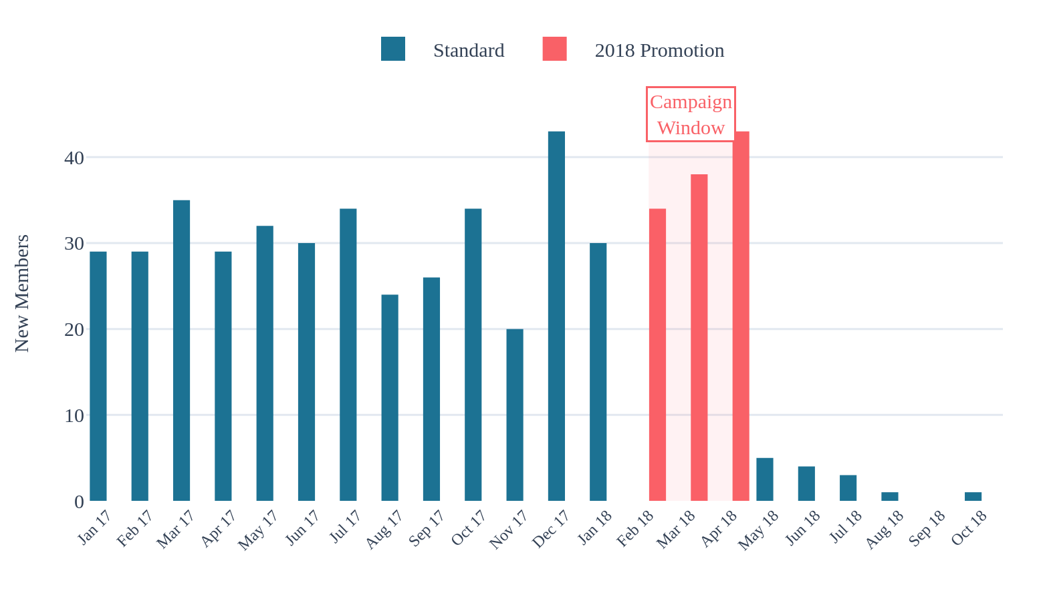
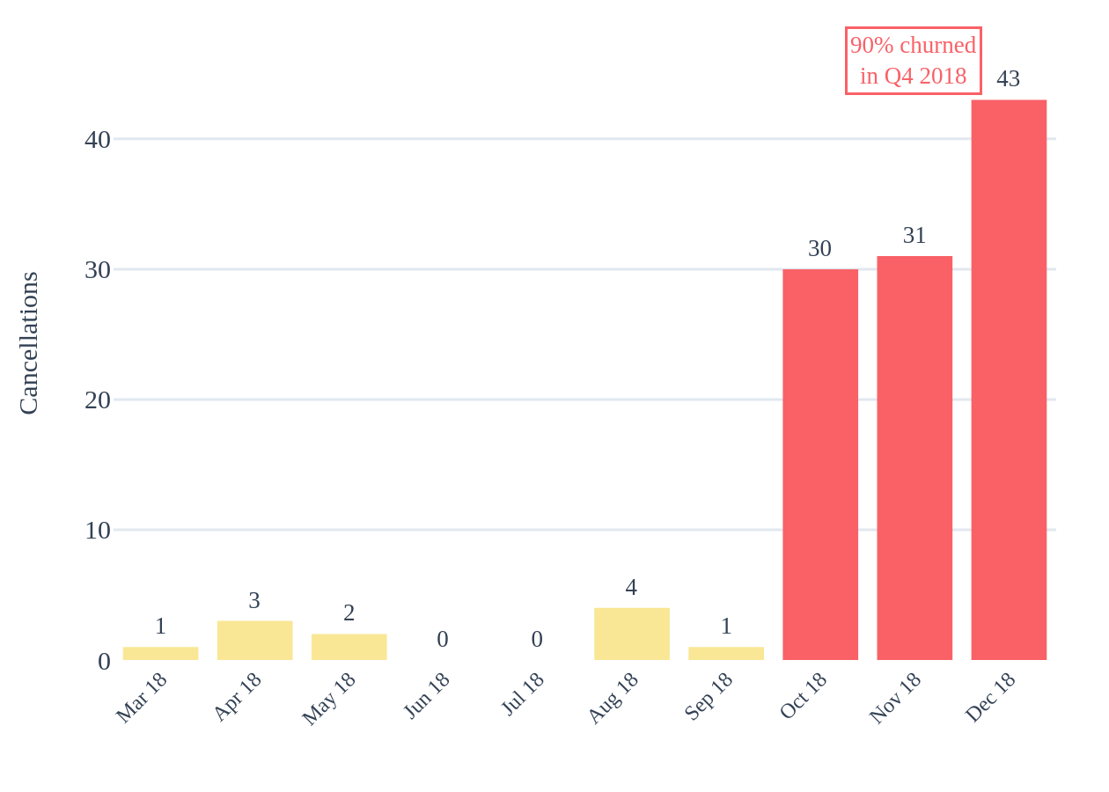
Campaign Impact on Memberships
Gross enrollments vs net retention from the 2018 Promotion campaign
115
0
104
7.6 mo
Gross Enrollments
Net Retained
Q4 2018 Churn
Avg Tenure
Feb–Apr 2018
100% cancelled
90% of all cancellations
Before cancellation
Monthly Enrollments by Type (2017–2018)
Promotion Member Cancellation Timeline

Slide 4
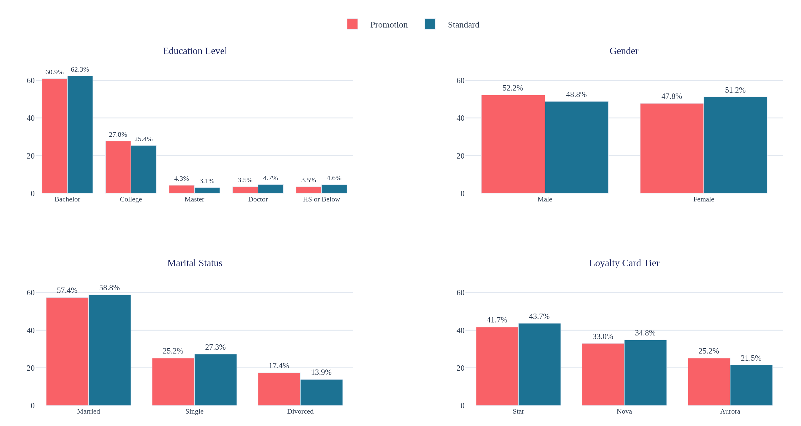
Demographic Adoption of the Campaign
Comparing % share of Promotion vs Standard members across demographics
+3.5pp
+3.7pp
+3.4pp
+2.5pp
Divorced Over-Index
Aurora Over-Index
Male Over-Index
College Over-Index
17.4% vs 13.9%
25.2% vs 21.5%
52.2% vs 48.8%
27.8% vs 25.4%

Slide 5
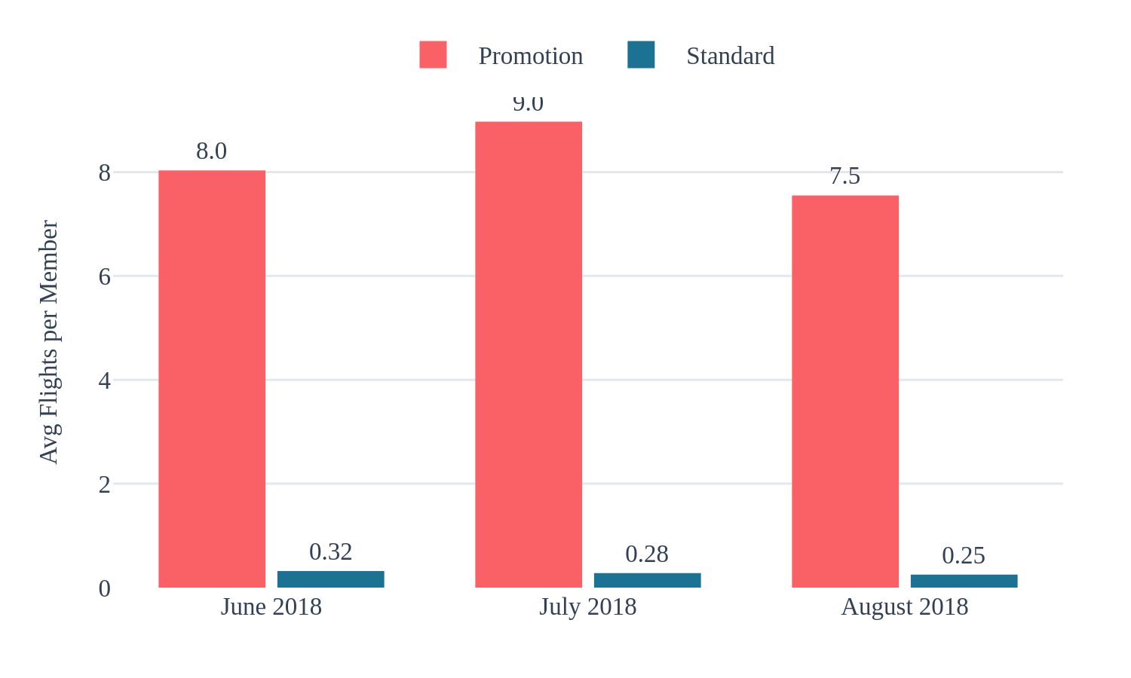
Summer Flight Activity Impact
Did the campaign drive incremental flight bookings during peak summer travel?
8.2
0.3
2,824
1,653
4.1M
Promo Avg Flights
Standard Avg Flights
Promo Total Flights
Standard Total Flights
Promo Distance
Per member, Jun–Aug
Per member, Jun–Aug
Summer 2018
Summer 2018
Total miles
Summer 2018 Supporting Metrics
Metric | Promotion | Standard
Members | 115 | 1,952
Total Flights | 2,824 | 1,653
Total Distance | 4,135,488 | 2,576,290
Avg Flights/Mo | 8.18 | 0.28
Promo members flew 27x more per person than Standard members during summer — but with only 115 members, the total impact was limited in scale.

Slide 6
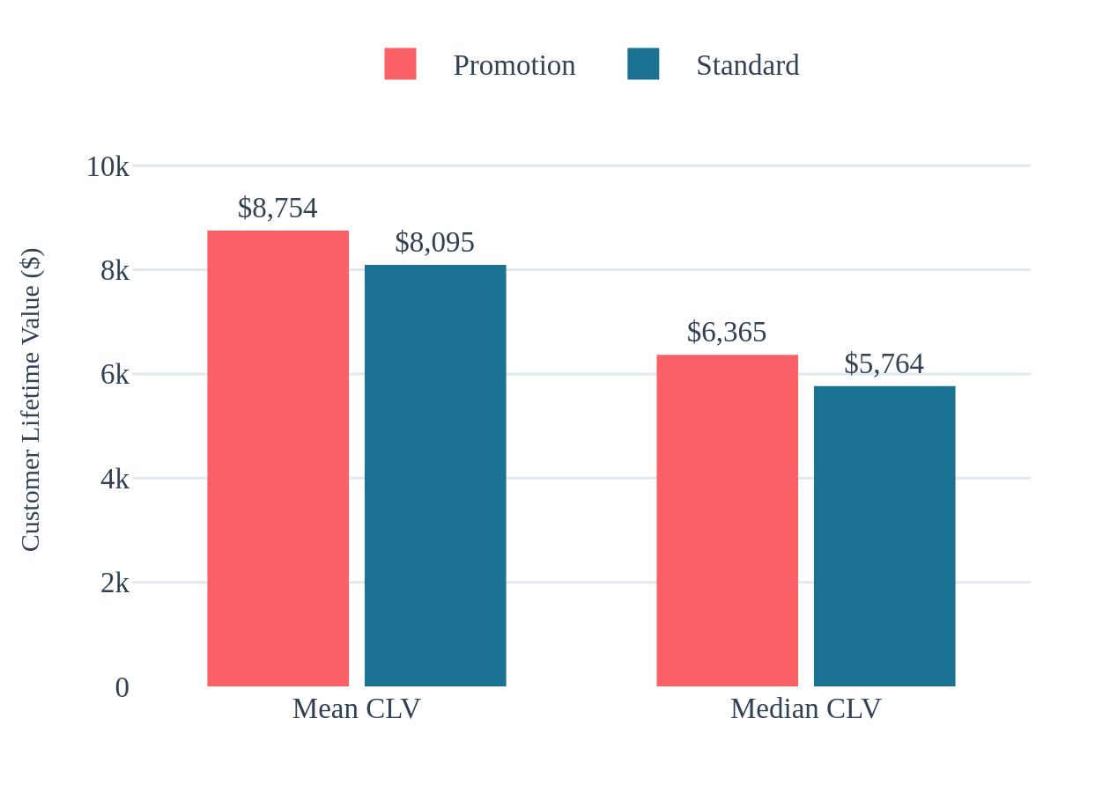
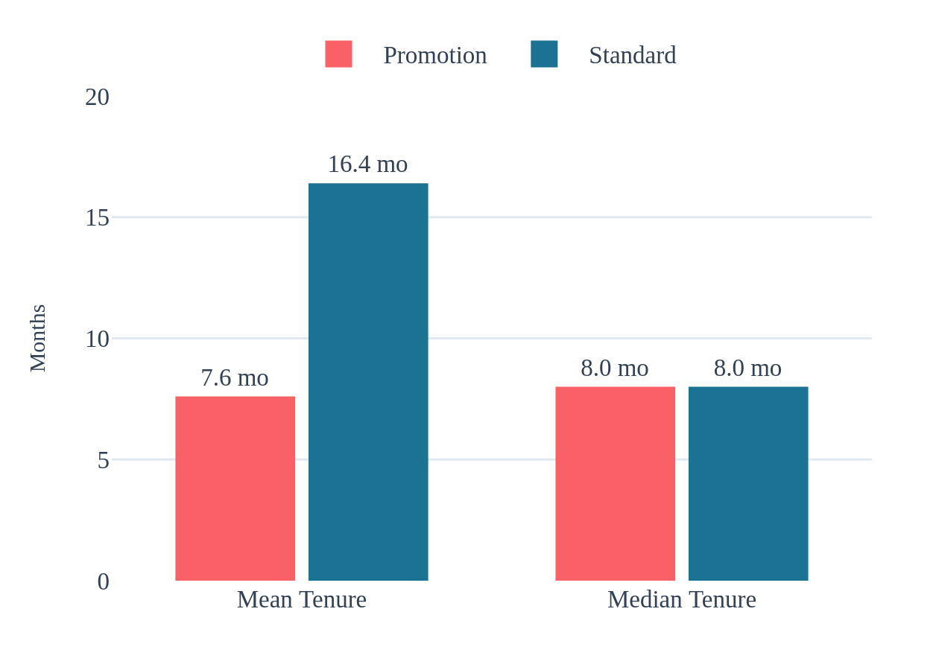
Member Lifetime Value & Retention
Comparing CLV and membership duration between enrollment types
$8,754
$8,095
7.6 mo
16.4 mo
Promo Mean CLV
Standard Mean CLV
Promo Avg Tenure
Std Avg Tenure
Higher than Standard
Across 1,952 members
Short-lived memberships
2.2x longer retention
Customer Lifetime Value Comparison
Membership Tenure Comparison

Slide 7
Key Takeaways & Recommendations
Strategic insights and next steps for future loyalty campaigns
Key Findings
Recommendations
1. Zero Net Retention
Campaign generated 115 gross enrollments but retained none. All members cancelled, with 90% churning in Q4 2018. This signals a fundamental retention gap.
2. Demographic Skew Reveals Targeting Opportunity
Divorced members (+3.5pp), Aurora cardholders (+3.7pp), and Males (+3.4pp) over-indexed. Future campaigns can double down on these responsive segments.
3. High Activity, Low Scale Impact
Promo members flew 27x more than Standard per person during summer — but with only 115 members, the campaign did not meaningfully boost total flight volume.
Implement Retention Programs
Add onboarding journeys, milestone rewards, and early-warning churn detection within the first 3 months of enrollment.
Refine Targeting Strategy
Focus acquisition efforts on the demographic segments that showed highest adoption rates: Divorced, Aurora-tier, and Male members.
Scale the Program
The high per-member flight activity (8.2 avg flights) suggests strong engagement when members stay. Expand the program with better incentives to reach a critical mass.
Measure Incrementality
Design the next campaign with a control group to measure true incremental value over the member lifecycle, not just acquisition counts.

